Slide 1

PowerCo
Exploratory Data Analysis
Nijadi Mohamed

Slide 2
Agenda
Clients Analysis
Prices Analysis
Conclusion

Slide 3
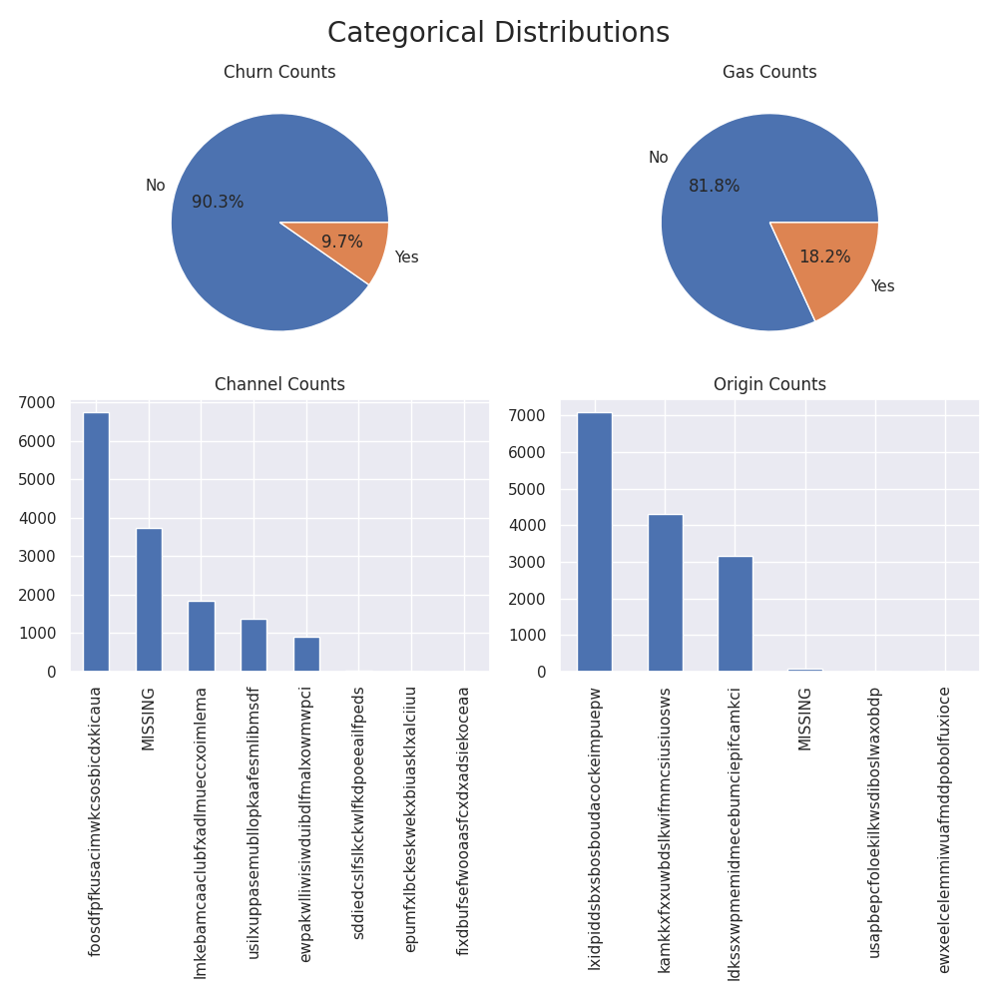
Client Analysis
How does the categories look like ?
- About 10% of customers has churned. Which could significantly impact the company's revenue.
- Most customers (about 80%) are only subscribed to electricity and not gas.
- Channel codes are not evenly distributed, with 3 codes almost never appearing.
- We only notice 3 groups of origin being omnipresent, the other 3 are very rare.
- It's also very good that we have a category for missing values, since we can see how they relate to churn.
Let's have closer look at the categories, and how they relate to churn.

Slide 4
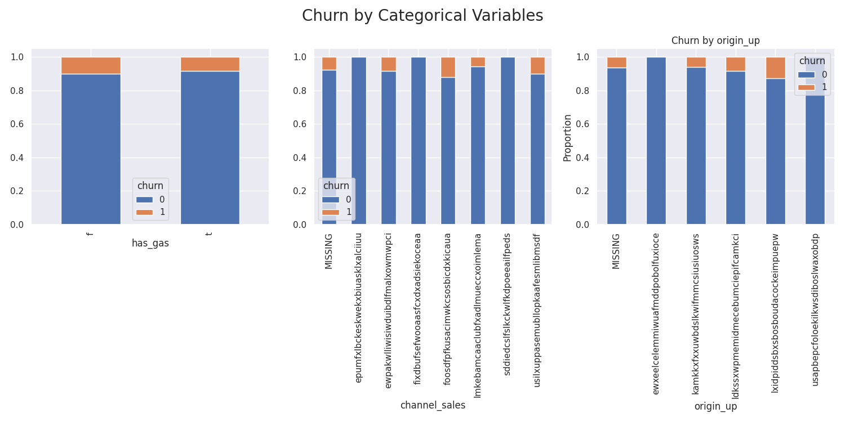
How is churn distributed across these categories ?

Slide 5
- Starting with gas, we can't see if there is a significant difference between the two categories. We'll have to look at the numbers in a chi-squared test.
- Looking at the contingency table and stacker bar chart for channels and origins, we see that we have categories with few observations that aren't a churn, maybe we'll have to group them later on if we include these variables in our model.

Slide 6
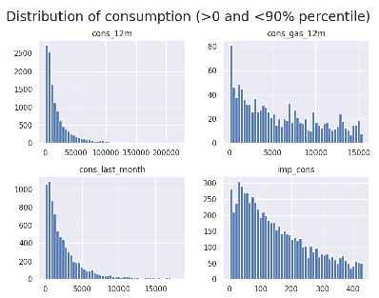
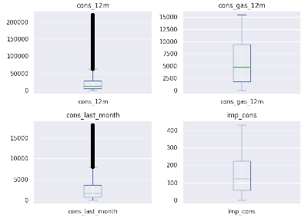
How does the measures look like ?

Slide 7
- Even after zooming in, we still have a high density of values in the lower values of consumption, and a large tail at the right with the high values.
- At the phase of feature engineering, we can easily mitigate the effect of outliers by using a log transformation.
- When we look at the distributions by churn, there is a distinction we can make, we see that the churned customers have a lower probability of having a high consumption.

Slide 8
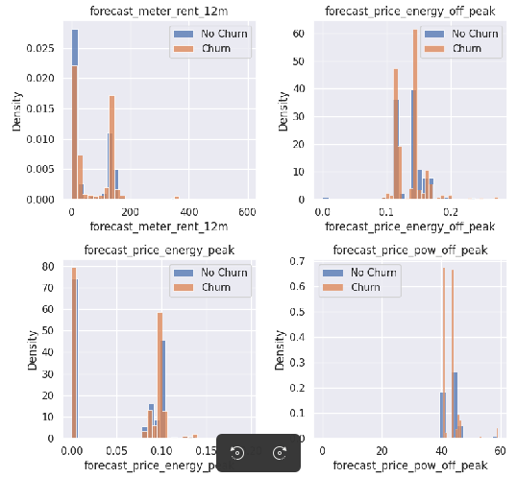
How does prices change by churn ?
Prices seem to be a good indicator of churn, as long as consumption as we've seen before, because even if the percentage of churn is low, we see high density around specific ranges of values, compared to non-churns, which are more spread out.

Slide 9
More insights from the clients’ dataset?
- The forecasted discount of 0 is omnipresent, this is because the company should rarely offer discounts.
- One good way I think of is grouping all forecasted discounts other than 0 into one category.
- Net and gross margins follow the same pattern, and they are perfectly correlated, and act as a good indicator of churn, so as the net margin.
- More categories are useful to model the churn variable, like the number of products activated, years of antiquity.
- Strong correlations exist between :
- current subscribed consumption and next year’s forecasted consumption.
- next year’s forecasted consumption and sme’s margin.

Slide 10
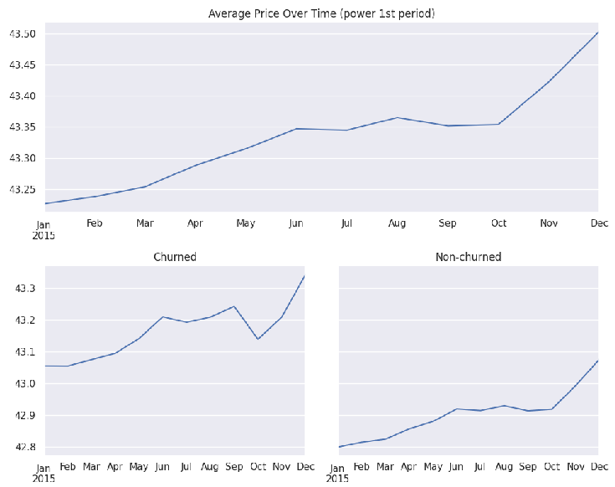
Prices Analysis
How is the evolution of prices for both churns and non churns ?
- Charts suggest that historical prices are very good when distinguishing between the two categories.
- In order to add this information to model churn, we can join clients with prices and add the average historical price to each client. This way wa have information on both past prices and future ones.

Slide 11
Conclusion

Slide 12
Conclusion
- To sum up, we have many variables from our datasets that we can use to explain the churn.
- Many groupings and feature engineering need to be done in order to remove redundant information and make the model simpler and more interpretable.
- It’s mandatory to look at both past prices and future prices, as they hold valuable insights about prices’ sensitivity.

